Slide 1
Data Mining DS-303
Lecture 8
Muhammad Arham
Lecturer
The University of Faisalabad

Slide 2
Content
Basics of Python & OOP for Data Mining

Slide 3
Basics of OOP for Data Mining

Slide 4
Featuers of OOP
Ability to simulate real-world event much more effectively
Code is reusable thus less code may have to be written
Data becomes active
Better able to create GUI (graphical user interface) applications
Programmers are able to produce faster, more accurate and better- written applications

Slide 5
Principles of Object Technology.

Slide 6
Core Concepts (Objects, Classes, Attributes)

Slide 7
Objects
Object is an instance of the class which has all the properties of its respective class.
Methods (functions), data variables
Runs
Wickets
Cricket
ShowRuns
Show Wickets

Slide 8
Class
A class is a templte or blueprint, from objects are created.
Objects are used to implement the classes.

Slide 9
Class
A class is a group of objects with same attributes and behavior
A class is user define derived class that conmbines both data and function and manipulate the data.

Slide 10
Attributes
Field or properties
Variables that hold data about the objects.

Slide 11
Methods
Functions
Action or behaviour that an object can perform

Slide 12
Method
A- method is a set of code which is refered to by name and can be called at any point in a program simply by utilization the method’s name.

Slide 13
Examples of Attribute and Methods
Attribute
car.color=”red”
Method
car.drive()

Slide 14
Instances
An instance is a specific realization of any object
The creation of a realization instance is called instantiation.
Each time a program runs, it is an instance of that program

Slide 15
Key Principles(Encapsulation, Inheritance, Polymorphism, Abstraction)

Slide 16
Encapsulation
Encapsulation is an object oriented programming concepts that binds together the data and function that manipulate the data and that keep both safe from outside interference and misuse.
In easy wording you can say that Encapsulation in OOP means wrapping data (variables) and functions (methods) into a single unit (class), and controlling who can access them.

Slide 17
Inheritance
Inheritance is the machanism that allow us to reuse the attributes and methods of one class in the implementation of another class.

Slide 18
Inheritance
Class A
Class A
Class A
Class B
Class B
Class B
Class C
Class C

Slide 19
Inheritance
Categories of inheritence
Single inheritence
In single inheritence, the child class inherits all data members and memberls functions of the base class.
Multiple inheritance
In multiple inheritance, the child class inherits all data member and member function of base class,

Slide 20
Inheritance
Types of inheritance
Public inheritance
Private inheritance
Protected inheritance

Slide 21
Inheritance
Public Inheritance
In Public inheritance , the access status of parent class member in the derived class remain the same.
The public member of parents class become public member of derived class.
The private members of parents class become private member of derived class.
The protected members ofparent class become protected member of derived class.

Slide 22
Inheritance
Protected Inheritance
In Protected inheritance , the access status of parent class member in the derived class is restricted.
The public member of parents class become protected members of derived class.
The private members of parents class become private member of derived class.
The protected members ofparent class become protected member of derived class.

Slide 23
Inheritance
Private Inheritance
In Public inheritance , the access status of parent class member in the derived class remain the same.
The public member of parents class become private member of derived class.
The private members of parents class become private member of derived class.
The protected members ofparent class become private members of derived class.

Slide 24
Polymorphism
The word polymorphism is a combination of two words poly and morphism. Poly means many and morphism means form.
Polymorphism is the ability of objects of differents types to respond to functions of the same name. The user does not have to know the exact type of the object in advance. The behavior of the object can be implemented at run time.

Slide 25
Polymorphism
Types of polymorphism
Virtual functions
Operator overloading
Function overloading

Slide 26
Abstraction
Data abstraction or information hiding refers to providing only essential information to the outside world and hiding their background details

Slide 27
Abstraction
Advantages of data abstraction
Simplification of software development
Testing and debugging
Reusability
Security
Modifications to the representation of a data type.

Slide 28
Advantages of OOP
Code reusability
Easy maintenance
Better organization
Real-world modeling

Slide 29
Basics of Python for Data Mining

Slide 30
What is Python?
Python is a general-purpose, high-level programming language
Created by Guido van Rossum in 1991
Easy to learn and readable syntax
Supports multiple programming paradigms, including object-oriented.

Slide 31
Python Features
High-level language
Interpreted — no compile step
Dynamic typing
Supports OOP, functional & procedural styles
Large standard library

Slide 32
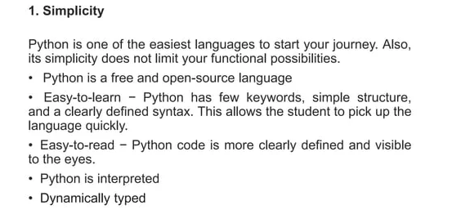
Reason to learn Python

Slide 33
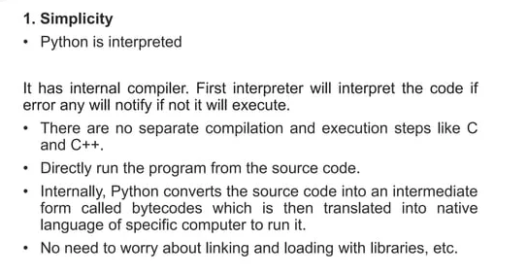
Reason to learn Python

Slide 34
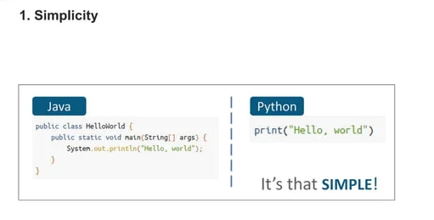
Reason to learn Python

Slide 35
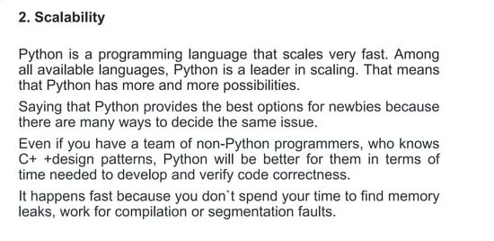
Reason to learn Python

Slide 36
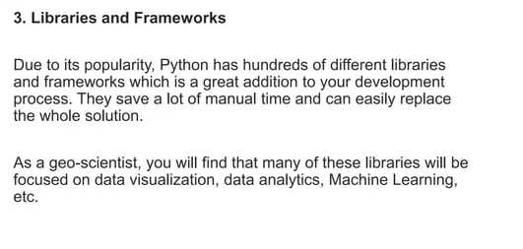
Reason to learn Python

Slide 37
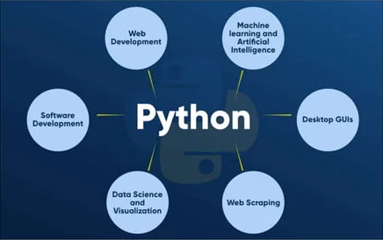
Application Area

Slide 38
Getting Started
Writing our first program
Print(“Hello world”)

Slide 39
Fundamental of Python
Python Comments
Comments are useful information that the developers provide to make the reader understand the source code. It explains the logic or aprat of its used in the code. There are two types of comments in Python:
Single line comments: Python single line comment starts with the hashtag symbol with no white spaces.
#this is comment
Multi-line string as comment: Pyhton multi-line comment is a piece of text enclosed in a delimiter (“””) on each end of the comment.
“”” this would be a multi line comment
In Python that spans several lines,
“””

Slide 40
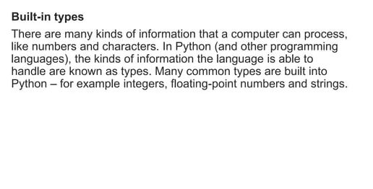
Fundamental of Python

Slide 41
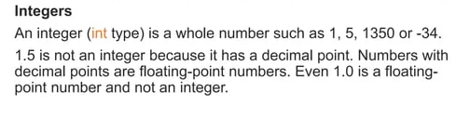
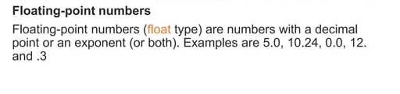
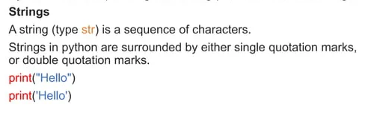
Fundamental of Python

Slide 42
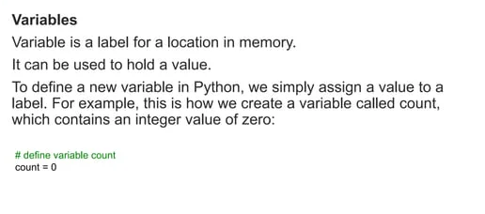
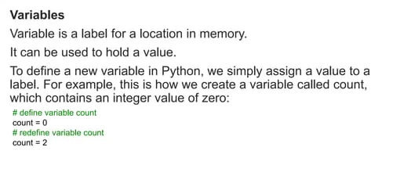
Fundamental of Python

Slide 43
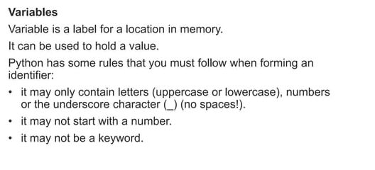
Fundamental of Python

Slide 44
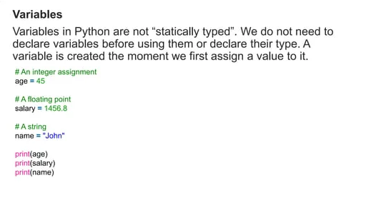
Fundamental of Python

Slide 45
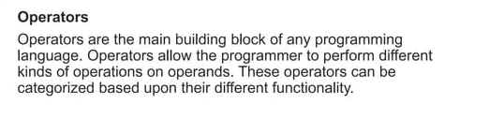
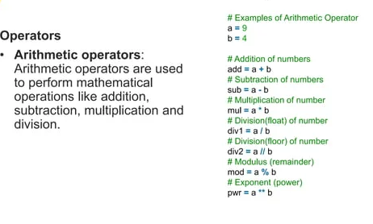
Fundamental of Python

Slide 46
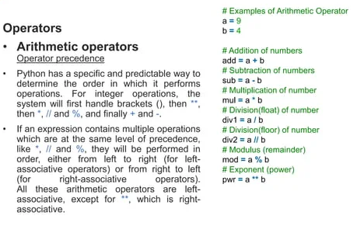
Fundamental of Python

Slide 47
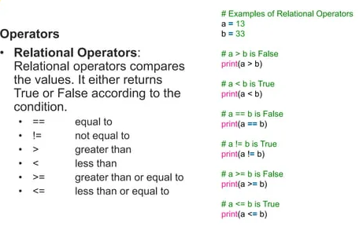
Fundamental of Python

Slide 48
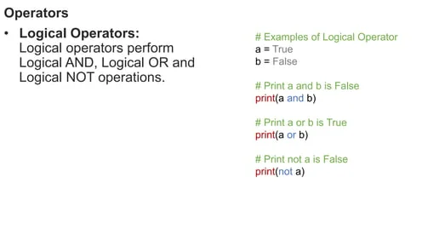
Fundamental of Python

Slide 49
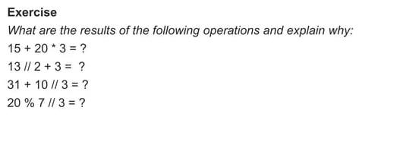
Fundamental of Python

Slide 50
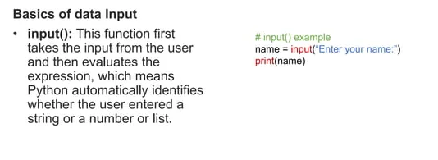
Fundamental of Python

Slide 51
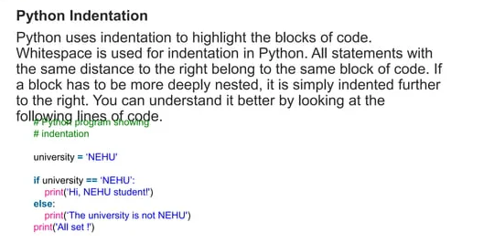
Fundamental of Python

Slide 52
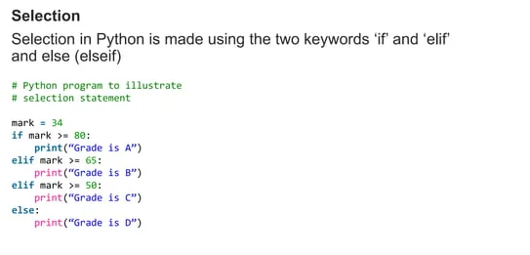
Fundamental of Python

Slide 53
Reference
https://www.slideshare.net/slideshow/oop-in-pyhton-updated/37383033#2
https://www.slideshare.net/slideshow/python-basics-260043993/260043993#2

Slide 54
Advice
Kindly read the book before and after the lecture, if some terms/ words are not covered in the lecture, if appear in exam it might not appear strange or out of course.

